Slide 1
Fraud Detection
Report : Models with both features kept during FE & EDA

Slide 2
Distance Based Algorithms
Logistic Regression
SVC
KNN
Accuracy score : 0.80264
Confusion matrix :
[[7434 1014]
[1453 2599]]
precision recall f1-score support
0 0.84 0.88 0.86 8448
1 0.72 0.64 0.68 4052
accuracy 0.80 12500
macro avg 0.78 0.76 0.77 12500
weighted avg 0.80 0.80 0.80 12500
Accuracy score : 0.77632
Confusion matrix :
[[8448 0]
[2796 1256]]
precision recall f1-score support
0 0.75 1.00 0.86 8448
1 1.00 0.31 0.47 4052
accuracy 0.78 12500
macro avg 0.88 0.65 0.67 12500
weighted avg 0.83 0.78 0.73 12500
Accuracy score : 0.81616
Confusion matrix :
[[7870 578]
[1720 2332]]
precision recall f1-score support
0 0.82 0.93 0.87 8448
1 0.80 0.58 0.67 4052
accuracy 0.82 12500
macro avg 0.81 0.75 0.77 12500
weighted avg 0.81 0.82 0.81 12500

Slide 3
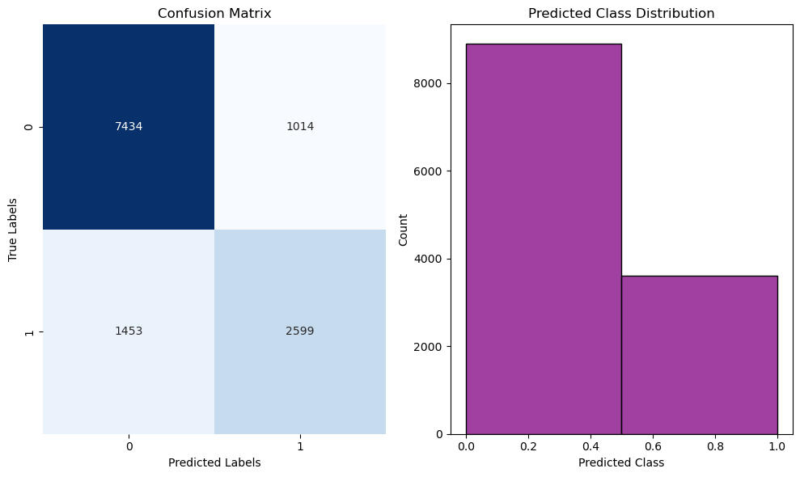
Distance Based Algorithms
Logistic Regression
SVC
KNN

